Slide 1
Team Alpha Update
November 27, 2023

Slide 2
Lines of Code Generated:
248!

Slide 3
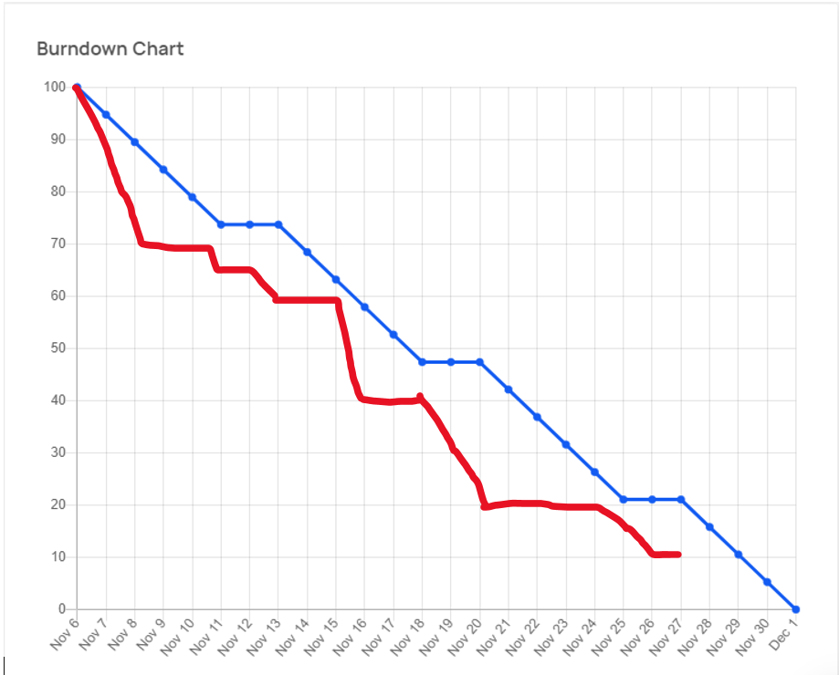
Burndown Chart

Slide 4
Implementation Update:
User Survey Exit Route Guard
Version History for Pages
Multifactor authentication

Slide 5
Remaining:
Unit Testing
Acceptance Testing

Slide 6
Still under budget and ahead of schedule!

